Slide 1
Board games data analysis
Dmitri Sajutinski, Taavi Aru, Elis Teemus

Slide 2
Motivation and goals
Our main interests:
What makes a board game good?
What parameters influence the success of a board game the most?
Our dataset consists of many attributes that define a board game - min and max amount of players, average playtime, min age of players etc.
We wanted to see how these attributes affect the average rating of a board game as well as how well we would be able to predict the rating based on these values.

Slide 3
Our Database
Our database:
19546 unique values
52 columns
1 data.csv file 32.78 MB
is from boardgamegeek.com
You can download our database from: https://www.kaggle.com/extralime/20000-boardgames-dataset

Slide 4
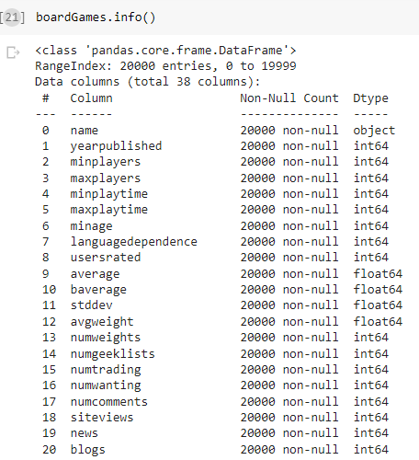
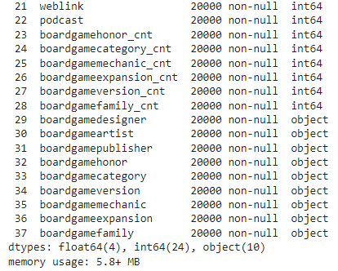
Database
BAD COLUMNS
‘sortindex’
'min_community'
'max_community'
'totalvotes'
'playerage'
'label'
'description'
'gamelink'
'objectid'
'numplays'
'numplays_month’
'boardgamedesigner_cnt'
'boardgameartist_cnt'
'boardgamepublisher_cnt'

Slide 5
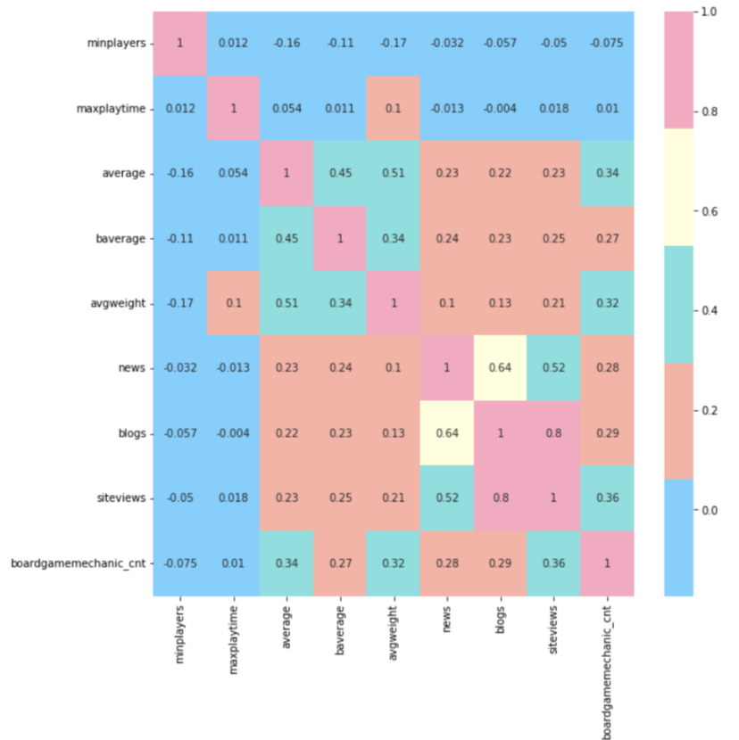
Correlation example
minplayer - minumum number of players per the publishers maxplaytime - maximum playtime per the publishers average - user average rating from 1-10 baverage - from the site, determined to be an anti-skewing effort by bgg with system added mid range ratings (from 1-10) avgweight - a complexity rating from 1-5 Weight news - number news articles on game blogs - number of blogs regarding game siteviews - number of views on the site boardgamemechanic_cnt - game mechanics count

Slide 6
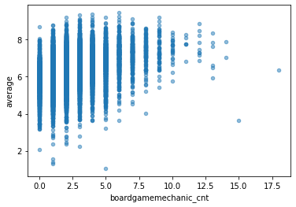
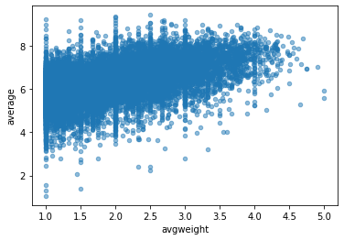
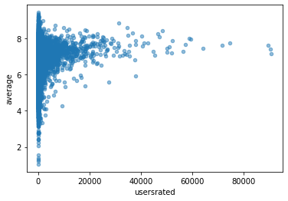
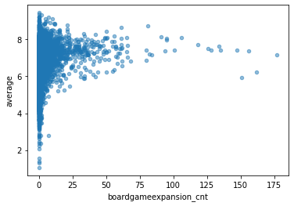
Things that surprise us…

Slide 7
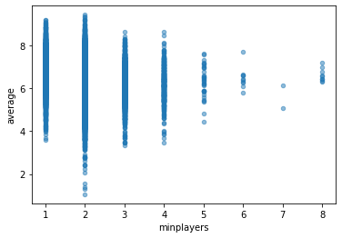
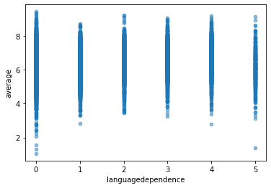
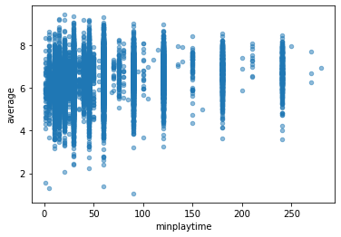
Things that surprised us…but sadly..

Slide 8
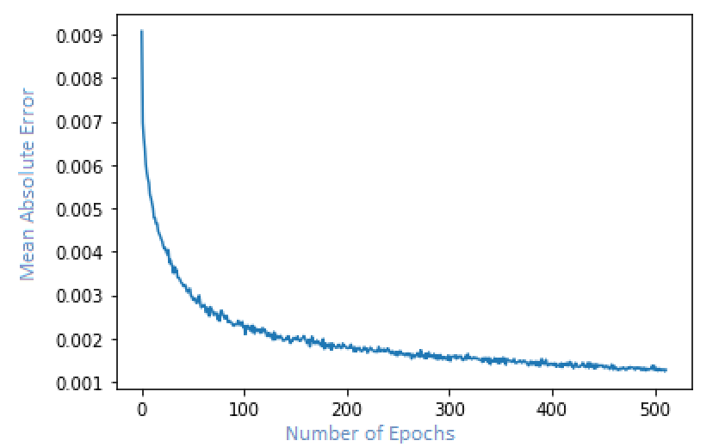
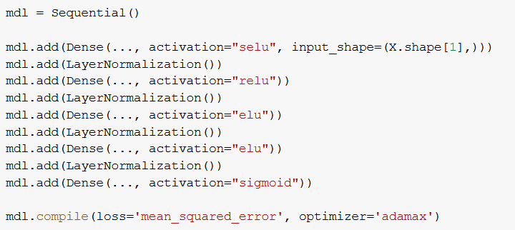
Main Goal Results Using Neural Net

Slide 9
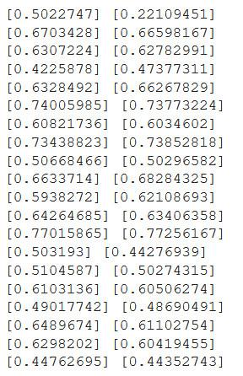
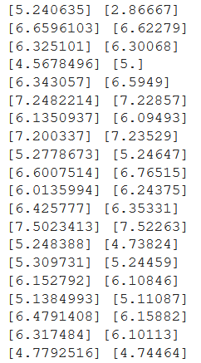
Prediction Results

